Slide 1

Diabetes Onset Prediction
Using Machine Learning
An end-to-end Predictive Analytics / KDD project on two independent diabetes datasets: Pima Indians (clinical measurements) and UCI Early Stage (symptoms)
Hardik Jain
PRN: 23070521056 | Predictive Analytics (CA-3)
2
datasets, modelled separately
5
models compared
RF
selected on both
Academic project: a screening-support model, not a medical diagnostic tool.
Notes:
Good morning. My project predicts whether a person is likely to have diabetes. I followed the complete KDD process on two independent datasets: the Pima Indians dataset with clinical measurements, and the UCI Early Stage dataset with self-reported symptoms. Because their features are different, they are not merged: each is modelled separately and only the results are compared. These are academic screening models, not diagnostic tools.

Slide 2












Interactive Agenda: click any topic
01
Problem & Objectives
02
Two Datasets
03
KDD Workflow
04
Data Understanding & EDA
05
Preprocessing
06
Models & Metrics
07
Dataset 1 Results
08
Dataset 2 Results
09
Comparison of Results
10
Interpretation (SHAP)
11
Conclusion & Future Scope
12
References
Notes:
This is the navigation hub. Each tile jumps straight to that part of the talk. In a normal run I simply press Next; during questions I can jump to any topic, for example the comparison of the two datasets (tile 9).

Slide 3



Problem, Motivation & Objectives
Problem & motivation
Objectives
Predict diabetes (yes / no + probability)
to flag people for clinical testing: a screening aid, not a diagnosis
Clean both datasets: invalid zeros and duplicates
1
2
Explore how each feature relates to diabetes
Two independent datasets
clinical measurements (Pima) and symptoms (UCI Early Stage), not merged
3
Build leak-free pipelines (fit on training data only)
Realistic data problems
invalid zeros (Pima) and duplicate records (Early Stage)
4
Compare 5 models on each dataset, same metrics
5
Select with a recall-aware rule, explain with SHAP
Notes:
Formally, for each dataset the input is a vector of features and the output is a class label plus a probability. I framed it as a screening problem: missing a diabetic person is worse than a false alarm, so recall gets special attention. The faculty asked for a second dataset; I chose the UCI Early Stage dataset because it uses a different kind of information (symptoms instead of lab values). The objectives are the same for both datasets, and the last step compares them.

Slide 4
Two Datasets, Analysed Separately
768
251
48.7 %
51.7 %
Pima patients · 8 clinical measurements · 35 % diabetic
unique Early Stage records (of 520) · 16 symptom features · 69 % diabetic
of Pima Insulin values missing (recorded as zeros)
of Early Stage rows are exact duplicates (removed)
Different features and populations, so the datasets are never merged: each is modelled separately and only the results are compared
Notes:
Dataset 1 is the Pima Indians dataset: 768 women, eight clinical measurements, 35 % diabetic. Its hidden problem is impossible zeros, which are really missing values: almost half of the insulin values. Dataset 2 is the UCI Early Stage Diabetes Risk dataset from a hospital in Bangladesh: 520 questionnaire records with age, gender and 14 yes/no symptoms. Its hidden problem is that 269 rows, more than half, are exact duplicates. I removed them before splitting, leaving 251 unique records, 69 % diabetic. The datasets have different features and populations, so they are analysed separately and never merged.

Slide 5
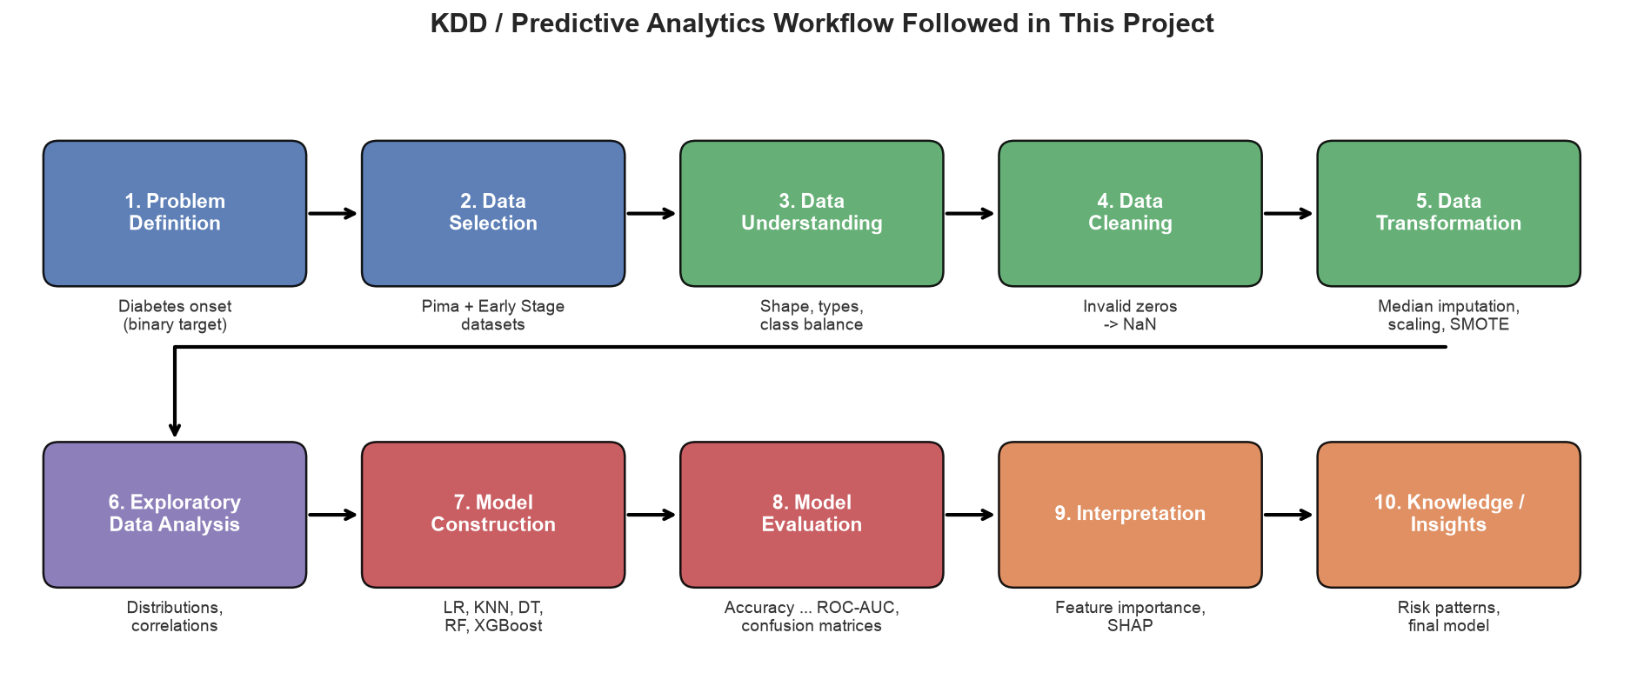

KDD / Predictive Analytics Workflow
Notes:
This diagram is the backbone of the project; I followed it once for each dataset. Data cleaning means the zero-to-NaN step for Pima and duplicate removal for the Early Stage data; transformation is imputation, scaling, encoding and, for Pima, SMOTE; interpretation is feature importance and SHAP.

Slide 6
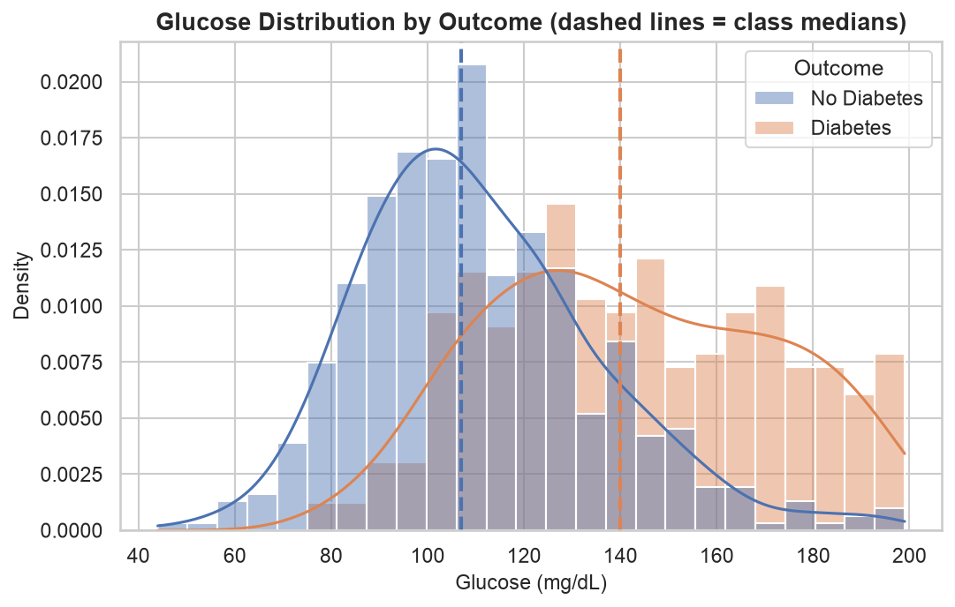
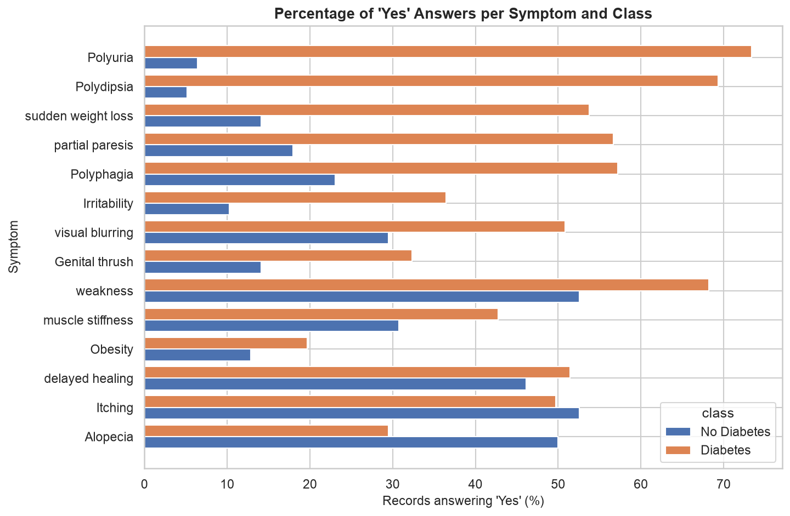




Data Understanding & EDA
Pima: Glucose separates best
median 140 vs 107 mg/dL (r = 0.49); BMI and age are also higher
Early Stage: Polyuria & Polydipsia
'Yes' in 73 % / 69 % of diabetic vs 6 % / 5 % of non-diabetic records
Associations in this sample, not causal effects
Notes:
For Pima, glucose separates the classes best: median 140 versus 107, correlation 0.49, but the distributions overlap. For the Early Stage data, I used the unique records; the classic symptoms polyuria and polydipsia, excessive urination and thirst, are reported by about 70 % of diabetic people but only 5 to 6 % of non-diabetic people. Several symptoms separate the classes strongly, so this dataset should be easier to predict. These are associations, not causes.

Slide 7
Preprocessing: Leak-Free Pipelines
Pima: zeros → NaN
Stratified 80/20 split
Median imputation
Standard scaling
SMOTE (train only)
Classifier
Early Stage: drop duplicates
Stratified 80/20 split
Impute + scale Age
One-hot encode symptoms
No SMOTE (0/1 answers)
Classifier
Imputation, scaling, encoding and SMOTE are learned from the training split only (614 Pima / 200 Early Stage rows), inside one pipeline
614 / 154
train / test rows for Pima (Early Stage: 200 / 51)
Never resampled
both test sets keep their real class ratio
0.57 → 0.72
Pima LR recall with SMOTE; for Early Stage, class weights lowered recall
Notes:
The key idea is leakage prevention. For both datasets I split first; every step that learns from data, such as medians, scaling, one-hot encoding and SMOTE, is fitted inside a pipeline on the training split only. For Pima, SMOTE balanced the training data and raised logistic regression's cross-validated recall from 0.57 to 0.72. For the Early Stage data I did not use SMOTE, because it would create impossible values like 0.37 for a yes/no answer. I tested class weights with cross-validation on the training data, and they lowered recall (0.878 vs 0.907) because there the minority class is the non-diabetic class, so I used no re-weighting.

Slide 8





Models & Evaluation Metrics
Logistic Regression
Linear, interpretable baseline
max_iter = 1000
K-Nearest Neighbors
Instance-based (distance)
k = 15 neighbours
Decision Tree
Rule-based tree
max_depth = 5, min_samples_leaf = 5
Random Forest
Bagging ensemble
300 trees, min_samples_leaf = 2
XGBoost
Gradient-boosting ensemble
200 trees, depth 3, lr 0.05
Same five models, settings, metrics and selection rule for both datasets
Accuracy
share of correct predictions
(TP + TN) / all
Precision
flagged people who are diabetic
TP / (TP + FP)
Recall
diabetic people caught (key for screening)
TP / (TP + FN)
F1
balance of precision and recall
2PR / (P + R)
ROC-AUC
ranking quality, all thresholds
area under ROC
Selection rule (both datasets): recall ≥ 0.70 in CV and test, then the highest mean of the 5 metrics over CV + test
Notes:
I compared five models from different families, from simple to complex, with the same settings on both datasets: logistic regression, KNN with k = 15, a depth-5 decision tree, a 300-tree random forest and a 200-tree XGBoost. Every model is evaluated with accuracy, precision, recall, F1 and ROC-AUC, using 5-fold cross-validation on the training data and one evaluation on the untouched test set. Recall matters most for screening because a false negative is a missed diabetic person. The final model is chosen with one rule: recall at least 0.70 in both cross-validation and the test set, then the best average of the five metrics.

Slide 9
Results: Dataset 1 – Pima (Test Set)
Final model
Random Forest
Recall 0.741 (40 of 54 caught)
ROC-AUC 0.809 (CV 0.829)
Precision 0.615, specificity 0.75
Recall ≥ 0.70 in both CV and test, highest overall score
XGBoost had the best test scores, but its cross-validated recall (0.687) failed the 0.70 screening rule
Notes:
For Pima, no model wins every metric. XGBoost has the best test AUC, but its cross-validated recall is below 0.70. Logistic Regression is best in cross-validation but worst on test recall. Random Forest is consistently first or second in both evaluations and meets the recall rule: it catches 40 of 54 diabetic patients, recall 0.741, ROC-AUC 0.809, cross-validated 0.829. The chart is a native PowerPoint chart, so values can be read on hover.

Slide 10
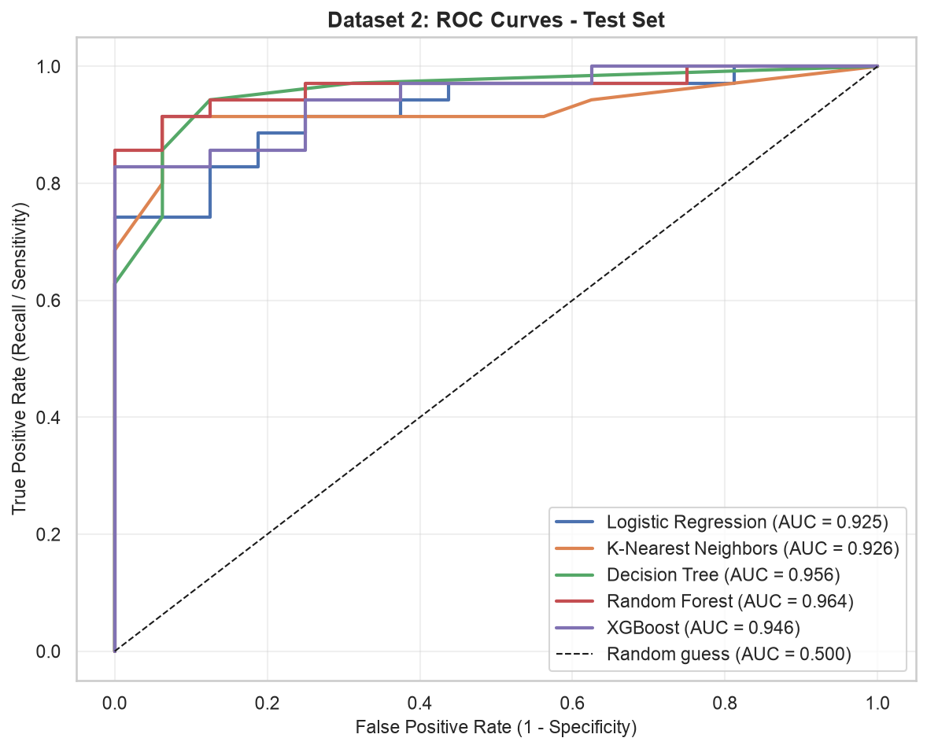
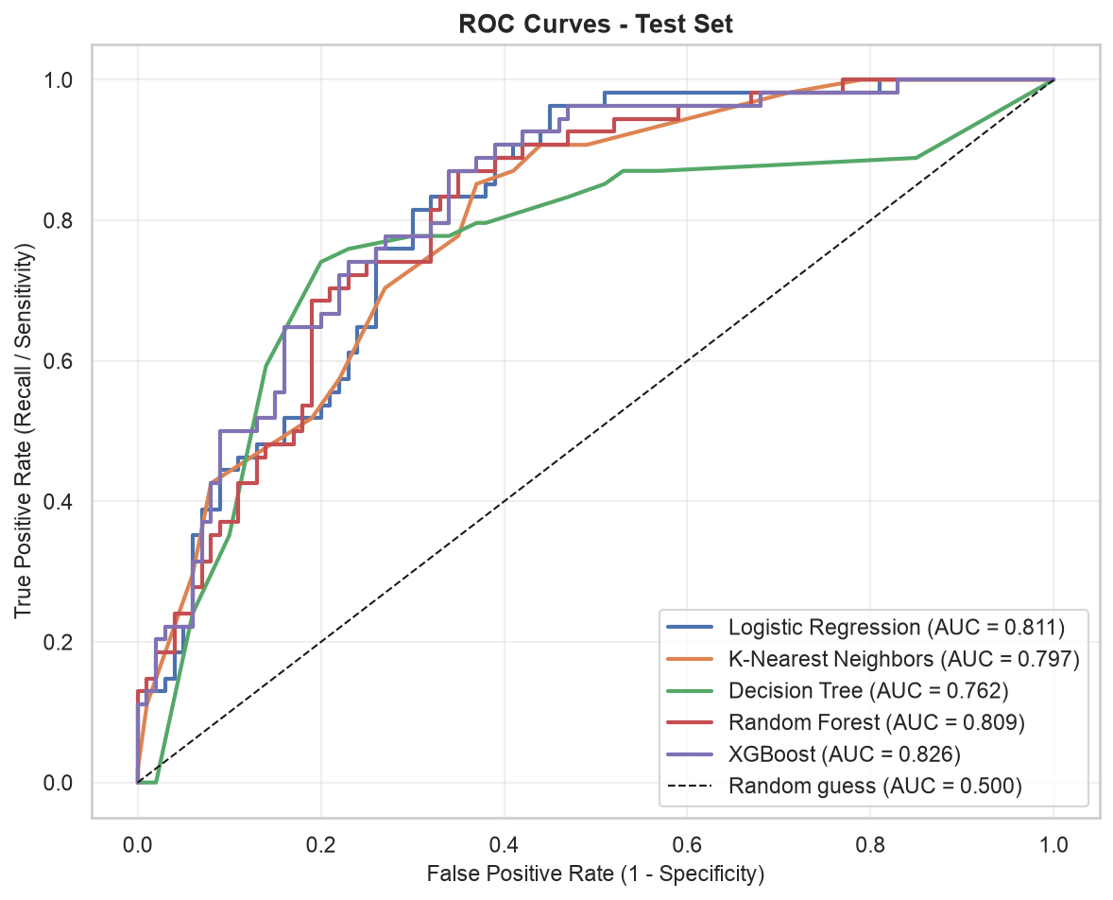
Results: Dataset 2 – Early Stage (Test Set)
Logistic Regression
ROC-AUC 0.925 | Recall 0.800 | FN 7
Eligible
K-Nearest Neighbors
ROC-AUC 0.926 | Recall 0.686 | FN 11
Rule failed
Decision Tree
ROC-AUC 0.956 | Recall 0.857 | FN 5
Eligible
Random Forest
ROC-AUC 0.964 | Recall 0.914 | FN 3
Selected
Final model: Random Forest (same rule as Dataset 1)
accuracy 0.902 · precision 0.941 · recall 0.914 · F1 0.927 · CV ROC-AUC 0.977
XGBoost
ROC-AUC 0.946 | Recall 0.829 | FN 6
Eligible
Notes:
On the Early Stage dataset all five models reach a ROC-AUC above 0.92. With the same selection rule, Random Forest is selected again: it catches 32 of 35 diabetic records (recall 0.914) with only 2 false alarms, ROC-AUC 0.964, cross-validated 0.977. XGBoost is a close second; KNN fails the recall rule. The test set has only 51 records, so one record changes recall by almost 3 points.

Slide 11
Comparison of Results: Same Models, Two Datasets
0.80 vs 0.94
average test ROC-AUC (Pima vs Early Stage): the symptom data is easier to predict
RF on both
the same recall-aware rule selects Random Forest for both datasets
0.97 → 0.90
Early Stage RF accuracy with vs without duplicates: removing them avoids inflated scores
Notes:
Here are the same five models on both datasets. The Early Stage dataset is clearly easier: average test ROC-AUC 0.94 versus 0.80, because its symptoms are strongly tied to the class, while Pima's clinical measurements overlap more. The models behave consistently: the same rule selects Random Forest on both, the ensembles and logistic regression lead in cross-validated ROC-AUC on both, and the single decision tree is last on both. KNN is the least consistent. If I had kept the duplicates, accuracy would have looked like 97 % instead of 90 %. The datasets differ in population, country, period and features, so this compares model behaviour, not which data source is better.

Slide 12
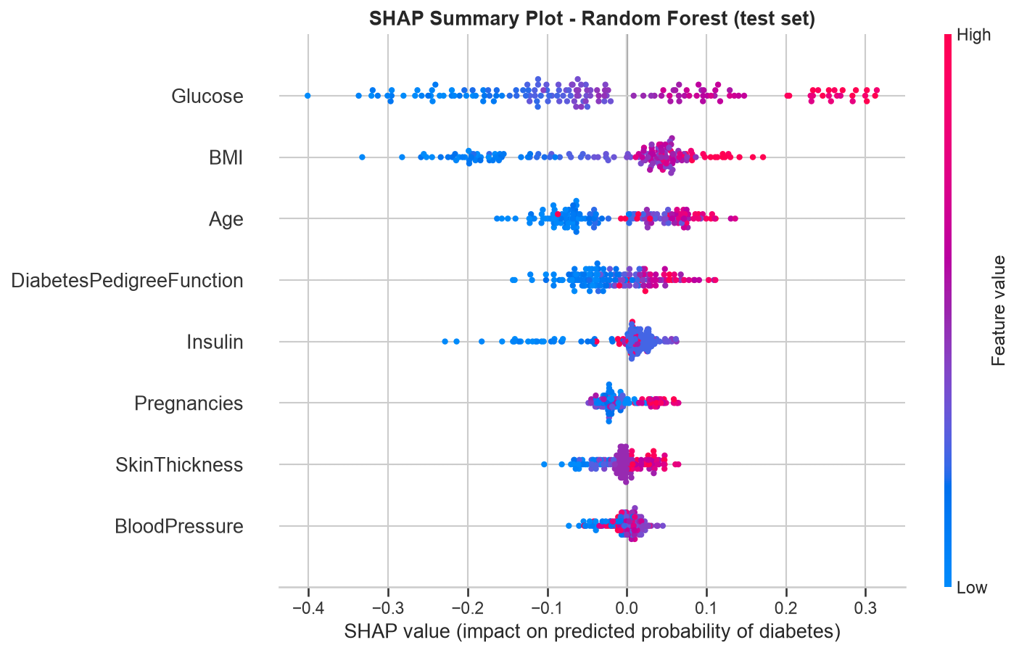
Interpretation (SHAP): What Drives the Predictions?
Pima: Glucose dominates (up to ~30 points of risk), then BMI and Age
Early Stage: Polyuria & Polydipsia dominate; male gender lowers risk
Both: top predictors are linked to high blood sugar; this explains the models, not biology
Dataset 1 – Pima (Random Forest): Glucose dominates
Notes:
In the Pima SHAP plot each dot is a test patient; red means a high value and dots on the right push toward diabetes. High glucose raises the predicted risk by up to about 30 points, followed by BMI and age. For the Early Stage model, polyuria and polydipsia have by far the largest SHAP values, and male gender pushes toward no diabetes in this sample. In both datasets the strongest predictors are the ones most directly linked to high blood sugar. SHAP explains how the model uses the data, not medical causation.

Slide 13
Conclusion & Future Scope
0.809
0.964
RF
Future scope
Larger, diverse datasets
Pima ROC-AUC (Random Forest)
Early Stage ROC-AUC (Random Forest)
selected on both datasets
External validation
Two independent datasets, one leak-free method; never merged
Key predictors: Glucose (Pima); Polyuria & Polydipsia (Early Stage)
Limitations: small, hospital-based or historical samples; imputed values; no external validation
Hyperparameter tuning
Calibration & thresholds
Drift monitoring
Thank you. Questions?
Academic screening demonstration, not a diagnostic tool
Notes:
To conclude: on both datasets routine information carries real predictive signal, and Random Forest gave the best balance of catching diabetic people and avoiding false alarms: ROC-AUC 0.809 on Pima and 0.964 on the Early Stage data. The symptom dataset is easier, but it is small, hospital-based and self-reported, and Pima is historical with many imputed values; neither model is externally validated. Before any real use, the models would need external validation, calibration and a carefully chosen threshold. Thank you, I'm happy to take questions.

Slide 14
References
[1] J. W. Smith et al., "Using the ADAP learning algorithm to forecast the onset of diabetes mellitus," Proc. Annu. Symp. Comput. Appl. Med. Care, pp. 261–265, 1988.
[2] M. M. F. Islam, R. Ferdousi, S. Rahman, H. Y. Bushra, "Likelihood prediction of diabetes at early stage using data mining techniques," Springer AISC, pp. 113–125, 2019.
[3] "Early Stage Diabetes Risk Prediction" [Dataset], UCI Machine Learning Repository, 2020, doi: 10.24432/C5VG8H.
[4] V. Vakil, S. Pachchigar, C. Chavda, S. Soni, "Explainable predictions of different machine learning algorithms used to predict early stage diabetes," arXiv:2111.09939, 2021.
[5] U. Fayyad, G. Piatetsky-Shapiro, P. Smyth, "From data mining to knowledge discovery in databases," AI Magazine, vol. 17, no. 3, 1996.
[6] N. V. Chawla et al., "SMOTE: Synthetic minority over-sampling technique," JAIR, vol. 16, pp. 321–357, 2002.
[7] L. Breiman, "Random forests," Machine Learning, vol. 45, pp. 5–32, 2001.
[8] T. Chen and C. Guestrin, "XGBoost: A scalable tree boosting system," Proc. ACM SIGKDD, pp. 785–794, 2016.
[9] S. M. Lundberg and S.-I. Lee, "A unified approach to interpreting model predictions," NeurIPS, 2017.
[10] F. Pedregosa et al., "Scikit-learn: Machine learning in Python," JMLR, vol. 12, pp. 2825–2830, 2011.
The full list (21 references, with a literature review) is in the project report.
Notes:
These are the main references: the original Pima study, the paper that introduced the Early Stage dataset and its UCI record, a recent SHAP study on the same symptom data, and the methods and libraries I used. The complete list is in the report.

